Slide 1
.NET 2 CA Presentation
Pragati Bharadwaja
Feng Yan
Shree Ramakrishnan

Slide 2
Outline
System Overview
Service Layer Overview
Design Consideration
Technology Consideration
Deployment Consideration
Research Review
Demo

Slide 3
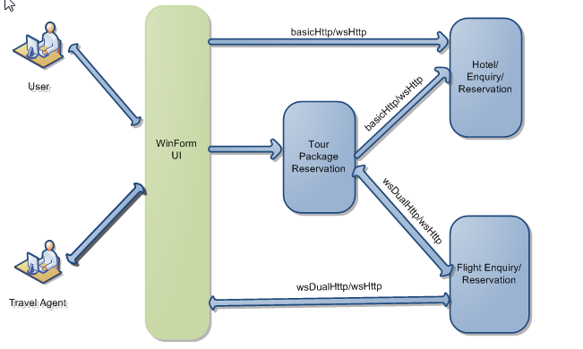
System Overview

Slide 4
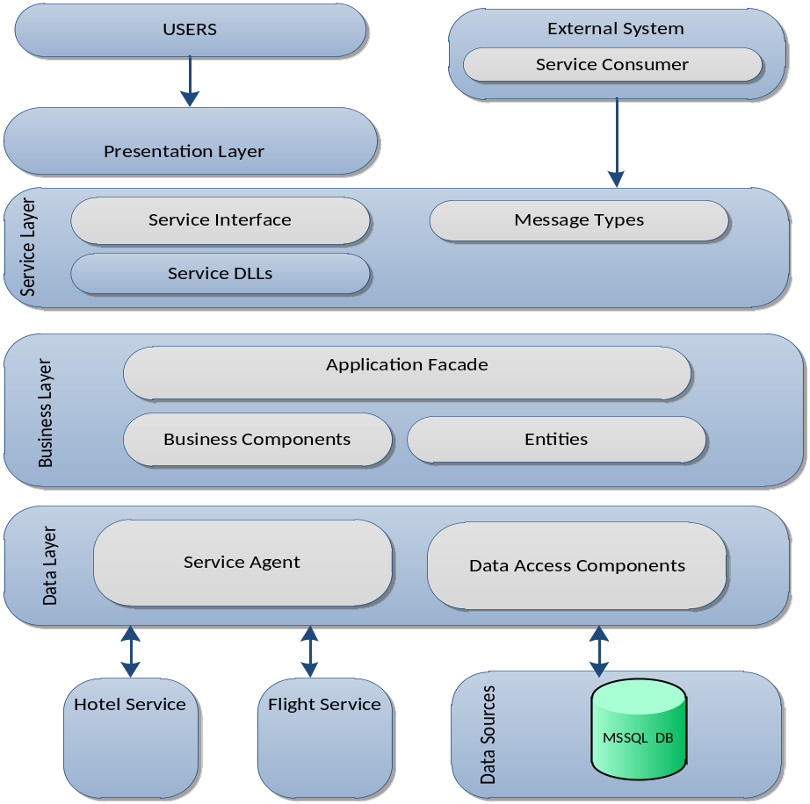
System Architecture

Slide 5
Identified Services
Flight Service
Hotel Service
Both services are coarse grained to reduce the number of calls made to the backend.

Slide 6
Flight Service - Interface
Enquiry Interface
  Retrieve Flight Details between two destinations
  Check Flight Availability
Reservation Interface
  Make Flight Reservation including payment
  Check Flight Availability

Slide 7
Flight Service – End Point
Enquiry Service
  wsDualHttpBinding
Reservation Service
  wsHttp binding

Slide 8
Flight Service – Message Type
Data Contract
  Defines the data types to be passed to and from the service.
    FlightInfo
    DestinationInfo
    PassengerInfo
    PaymentInfo

Slide 9
Hotel Service - Interfaces
Enquiry Interface
  Retrieve Hotel Room Information
  Check Room Availability
Reservation Interface
  Make Reservation
  Make Payment
  Check Room Availability

Slide 10
Hotel Service –End Point
Enquiry Service
  basicHttp binding
Reservation Service
  wsHttp binding

Slide 11
Hotel Service - Message Types
Message Contract - Payment Information
  Digitally sign and encrypt sensitive information
  Complete control over SOAP message by having access to header and body
Data Contract - Hotel Information
  Transform entities into coarse-grained datatypes used by a service

Slide 12
Design Consideration
Communication
Authentication
Exception Management
Message Transformation
Validation
Message Protection
Service Interface

Slide 13
Communication
HTTP Protocol is chosen based on main concerns from interoperability and deployment
Interoperability | In WCF, the HTTP transport binding is optimized for interoperability with non-WCF or non-Windows clientssystems.
Hosting | IIS 6.0 and earlier support only hosting applications that use the HTTP transport.
Inspection | Inspection is the ability to extract and process information from messages during transmission. The HTTP protocol separates routing and control information from data, making it easier to build tools that inspect and analyze messages. Transports that are easy to inspect may also require less processing power in network appliances. The level of security used impacts whether messages can be inspected.
Reach | The reach of a transport reflects how capable the transport is at connecting with other systems. The named pipe transport has very little reach; it can only connect to services running on the same machine. HTTP transport has excellent reach and can penetrate some NAT and firewall configurations
Tooling | Tooling represents third-party application support for a protocol for development, diagnosis, hosting, and other activities. Developing tools and software to work with the HTTP protocol signifies a particularly large investment.
Interoperability | In WCF, the HTTP transport binding is optimized for interoperability with non-WCF or non-Windows clients systems.
Hosting | IIS 6.0 and earlier support only hosting applications that use the HTTP transport.
Inspection | The HTTP protocol separates routing and control information from data, making it easier to build tools that inspect and analyze messages. Transports that are easy to inspect may also require less processing power in network appliances. The level of security used impacts whether messages can be inspected.
Reach | The reach of a transport reflects how capable the transport is at connecting with other systems. The named pipe transport has very little reach; it can only connect to services running on the same machine. HTTP transport has excellent reach and can penetrate some NAT and firewall configurations
Tooling | Tooling represents third-party application support for a protocol for development, diagnosis, hosting, and other activities. Developing tools and software to work with the HTTP protocol signifies a particularly large investment.

Slide 14
Communication (continued)
Duplex communication selected for the Flight Query Service.
  Assumption – people query system to check availability more often.
  InstanceContextMode – Single
  ConcurrencyMode – Multiple
  One-way communication

Slide 15
Authentication
MessageContract is used for custom authentication and authorization.
  The message is packed with security information at client side in the MessageHeader
  The Service intercepts this message, and works out the authentication/authorization by taking the data out of the MessageHeader.

Slide 16
Exception Handling
SOAP-based applications use SOAP fault messages to communicate processing error
Managed exception must be converted into SOAP faults on the service and converted from SOAP faults to fault exceptions in WCF clients

Slide 17
Exception Handling - FaultException
we use FaultException class to create an untyped fault to return to the client for debugging purposes.
Client will catch FaultException objects to handle unknown or generic faults

Slide 18
Message Transformation
Data contract (FlightInfo) is a wrapped class which contains information from multiple business layer classes.
Flight Info data member | Data From Class
AdultRate | Route
ChildRate | Route
EndCityCode | Destination
EndCityName | Destination
StartCityCode | Destination
StartCityName | Destination
FlightName | Flight
FlightTime | Route
NumSeatsAvailable | <Computed field>

Slide 19
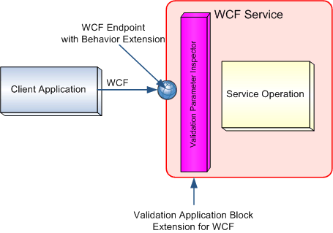
Validation
Adopt Microsoft EnterpriseLibrary VAB(Validation Application Block) to separate validation requirement of the ontracts from the flow of business logic

Slide 20
Validation(Continued)
Parameter-Level Validation
  For Primitive types : [NOTNULLValidator]/[RangeValidator]
  For Data Contracts:
    Use [HasSelfValidation] to annotate the data contract
    Define a validate() method with [SelfValidation]
  Validation Results
  Specify [FaultContract] attribute for each service operation with a validation attached
  Define ValidationFault Class which is wrapped by FaultException to be return value

Slide 21
Message Protection
We use ProtectionLevel property to control how a message is protected.
There are three basic levels of protection:
  None: for non-sensitive information
  Sign: detection of any tampering with the protected message part.
  EncryptAndSign: ensure confidentiality before message is signed.

Slide 22
Service Interface
Coarse-grained
  E.g merge several entities info into one data contract to minimize the number of calls
Service Interface design
  Changes to business logic should not affect the service interface.

Slide 23
Technology Consideration

Slide 24
Deployment Consideration
Windows services

Slide 25
DEMO

Slide 26
Research
Reliable Messaging

Slide 27
Research
Problem
  inherent lack of transport reliability of HTTP
    Transport level failures
    Message level failures
    Sequence of delivery

Slide 28
Research
Solution
  WCF implementation of WS-RM
    Reliable Session
      Retries communication on failure and
      allows delivery assurances to be specified, such as in-order arrival of messages.

Slide 29
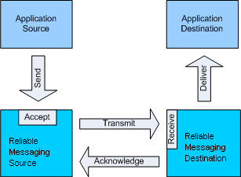
Research
Working

Slide 30
Research
Features
  Cache
  Ordered Delivery
  Flow Control
  Auto Acknowledgement

Slide 31
Research
Protocol Supported
  HTTP-based transport standard bindings:
    WsHttpBinding and expose request-reply or one-way contracts.
    WsDualHttpBinding and expose duplex, request-reply, or one-way contracts.
    WsFederationHttpBinding and expose request-reply or one-way contracts.
  TCP-based transport standard bindings:
    NetTcpBinding and expose duplex, request reply, or one-way contracts.

Slide 32
Reliable Messaging
DEMO

Slide 33
Q & A

Slide 34
Thank you

